Slide 1
AI IN HEALTHCARE THAT WILL MAKE YOU FEEL BETTER ABOUT THE FUTURE

Slide 2
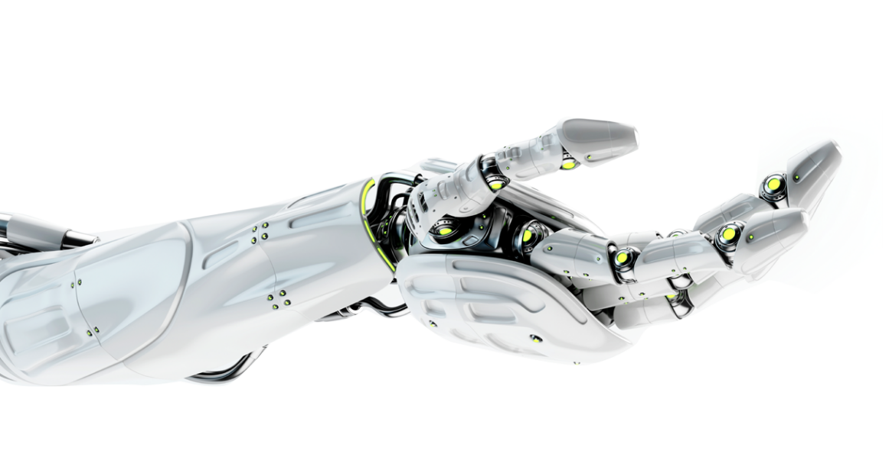
How is AI contribute to medical health?

Slide 3
The duration of the performing tasks is less than before.
USING AI TO EFFICIENTLY DIAGNOSE AND REDUCE ERROR
The risk of the operation failure can not compared with before.
In 2015, misdiagnosing illness and medical error accounted for 10% of all US deaths.
Incomplete medical histories and large case loads can lead to deadly human errors. Immune to those variables.
AI can predict and diagnose disease at a faster rate than most medical professionals. In one study, for example, an AI model using algorithms and deep learning diagnosed breast cancer at a higher rate than 11 pathologists.
One of the world's highest-growth industries, the AI sector was valued at about $600 million in 2014 and is projected to reach a $150 billion by 2026.

Slide 4
AI APPLICATIONS IN HEALTHCARE
AI has countless applications in healthcare. Whether it’s being used to discover links between genetic codes, to power surgical robots or even to maximize hospital efficiency, AI has been a boon to the healthcare industry.

Slide 5
There are six ways AI is reducing errors and saving lives.

Slide 6
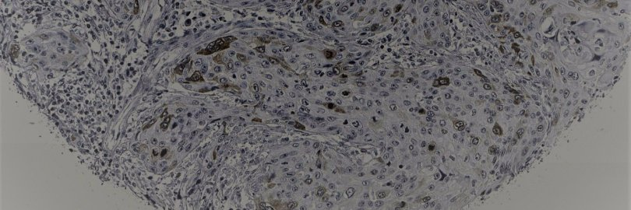
PATHAI :MORE ACCURATE CANCER DIAGNOSIS WITH AI
How it's using AI in healthcare: PathAI is developing machine learning technology to assist pathologists in making more accurate diagnoses. The company's current goals include reducing error in cancer diagnosis and developing methods for individualized medical treatment.
PathAI has worked with drug developers like Bristol-Myers Squibb and organizations like the Bill & Melinda Gates Foundation to expand its AI technology into other healthcare industries.

Slide 7
BUOY HEALTH
How it's using AI in healthcare: Buoy Health is an AI-based symptom and cure checker that uses algorithms to diagnose and treat illness. Here's how it works: a chatbot listens to a patient’s symptoms and health concerns, then guides that patient to the correct care based on its diagnosis.
Harvard Medical School is just one of the many hospitals and healthcare providers that uses Buoy’s AI to help diagnose and treat patients more quickly.

Slide 8
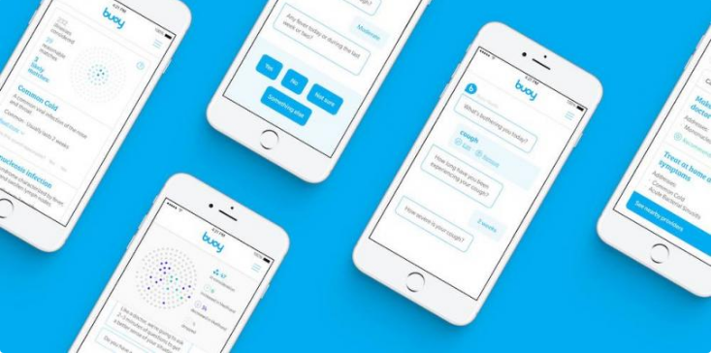

Slide 9
ENLITIC AI DEEP LEARNING FOR ACTIONABLE INSIGHTS
How it's using AI in healthcare: Enlitic develops deep learning medical tools to streamline radiology diagnoses. The company’s deep learning platform analyzes unstructured medical data (radiology images, blood tests, EKGs, genomics, patient medical history) to give doctors better insight into a patient’s real-time needs.
MIT named Enlitic the 5th smartest artificial intelligence company in the world, ranking above Facebook and Microsoft.

Slide 10
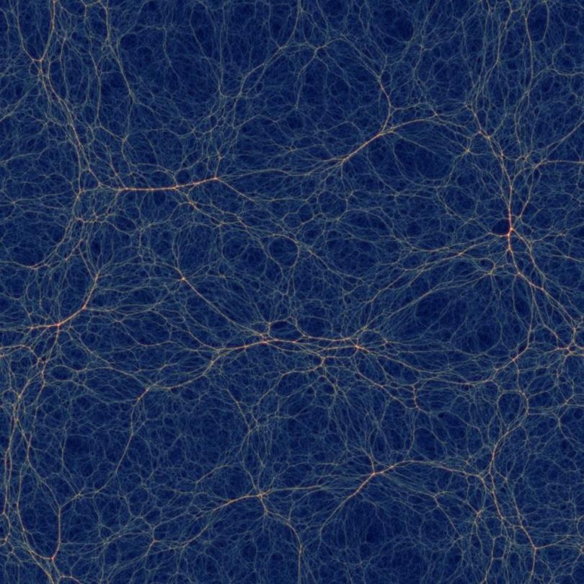

Slide 11
FREENOME EARLIER CANCER DETECTION WITH AI
How it's using AI in healthcare: Freenome uses AI in screenings, diagnostic tests and blood work to test for cancer. By deploying AI at general screenings, Freenome aims to detect cancer in its earliest stages and subsequently develop new treatments.

Slide 12
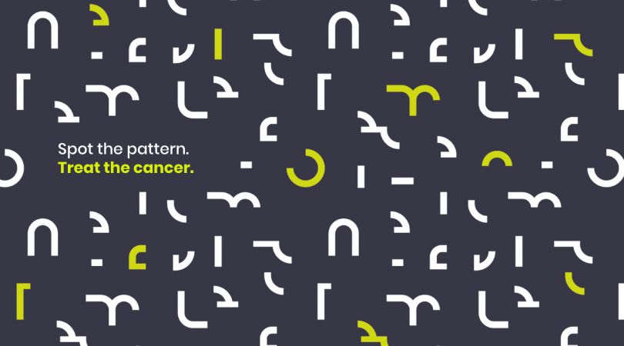

Slide 13
How it's using AI in healthcare: Harvard University’s teaching hospital, Beth Israel Deaconess Medical Center, is using artificial intelligence to diagnose potentially deadly blood diseases at a very early stage.
Doctors are using AI-enhanced microscopes to scan for harmful bacterias (like E. coli and staphylococcus) in blood samples at a faster rate than is possible using manual scanning. The scientists used 25,000 images of blood samples to teach the machines how to search for bacteria. The machines then learned how to identify and predict harmful bacteria in blood with 95% accuracy.

Slide 14
BIOXCEL THERAPEUTICS AI IN BIOPHARMACEUTICAL DEVELOPMENT
How it's using AI in healthcare: BioXcel Therapeutics uses AI to identify and develop new medicines in the fields of immuno-oncology and neuroscience. Additionally, the company’s drug re-innovation program employs AI to find new applications for existing drugs or to identify new patients.
BioXcel Therapeutics’ work in AI-based drug development was named as one of the “Most Innovative Healthcare AI Developments of 2019."

Slide 15
BERG HEALTH TREATING RARE DISEASE WITH AI
How it's using AI in healthcare: BERG is a clinical-stage, AI-based biotech platform that maps diseases to accelerate the discovery and development of breakthrough medicines. By combining its “Interrogative Biology” approach with traditional R&D, BERG can develop more robust product candidates that fight rare diseases.
BERG recently presented its findings on Parkinson’s Disease treatment — they used AI to find links between chemicals in the human body that were previously unknown — at the Neuroscience 2018 conference.

Slide 16
XTALPI AI, CLOUD-BASED DIGITAL DRUG DISCOVERY
How it's using AI in healthcare: Combining AI, the cloud and quantum physics, XtalPi’s ID4 platform predicts the chemical and pharmaceutical properties of small-molecule candidates for drug design and development. Additionally, the company claims its crystal structure prediction technology (aka polymorph prediction) predicts complex molecular systems within days rather than weeks or months.
XtalPi's big-name investors include Google, Tencent and Sequoia Capital.

Slide 17
ATOMWISE NEURAL NETWORK FOR CLINICAL TRIALS
Location: San Francisco, California
How it's using AI in healthcare: Atomwise uses AI to tackle some of today's most serious diseases, including Ebola and multiple sclerosis.
The company's neural network, AtomNet, helps predict bioactivity and identify patient characteristics for clinical trials. Atomwise’s AI technology screens between 10 and 20 million genetic compounds each day and can reportedly deliver results 100 times faster than traditional pharmaceutical companies.

Slide 18
DEEP GENOMICS FINDING BETTER CANDIDATES FOR DEVELOPMENTAL DRUGS
Location: Toronto, Canada
How it's using AI in healthcare: Deep Genomic’s AI platform helps researchers find candidates for developmental drugs related to neuromuscular and neurodegenerative disorders. Finding the right candidates during a drug's development has statistically raised the chances of successfully passing clinical trials while also decreasing time and cost to market.
Deep Genomics is also working on “Project Saturn,” which analyzes over 69 billion different cell compounds and provides researchers with feedback.

Slide 19
BENEVOLENTAI DEEP LEARNING FOR TARGETED TREATMENT
Location: London, England
How it's using AI in healthcare: The primary goal of BenevolentAI is to get the right treatment to the right patients at the right time by using artificial intelligence to produce a better target selection and provide previously undiscovered insights through deep learning.
BenevolentAI is working with major pharmaceutical groups to license drugs, while also partnering with charities to develop easily transportable medicines for rare diseases.

Slide 20
STREAMLINING PATIENT EXPERIENCE WITH AI
In the healthcare industry, time is money. Efficiently providing a seamless patient experience allows hospitals, clinics and physicians treat more patients on a daily basis.
US hospitals saw more than 35 million patients in 2016, each with different ailments, insurance coverage and conditions that factor into providing service. A 2016 study of 35,000 physician reviews revealed 96% of patient complaints are about lack of customer service, confusion over paperwork and negative front desk experiences.
New innovations in AI healthcare technology are streamlining the patient experience, helping hospital staff process millions, if not billions of data points, faster and more efficiently. We've rounded up six examples of how AI is helping healthcare facilities better manage patient flow.

